Slide 1
Not Just Boxes and Arrows: The Science of Clinical Pathways
Pathways4Kids National Collaborative
Amy Tyler, MD, MSCS

Slide 2
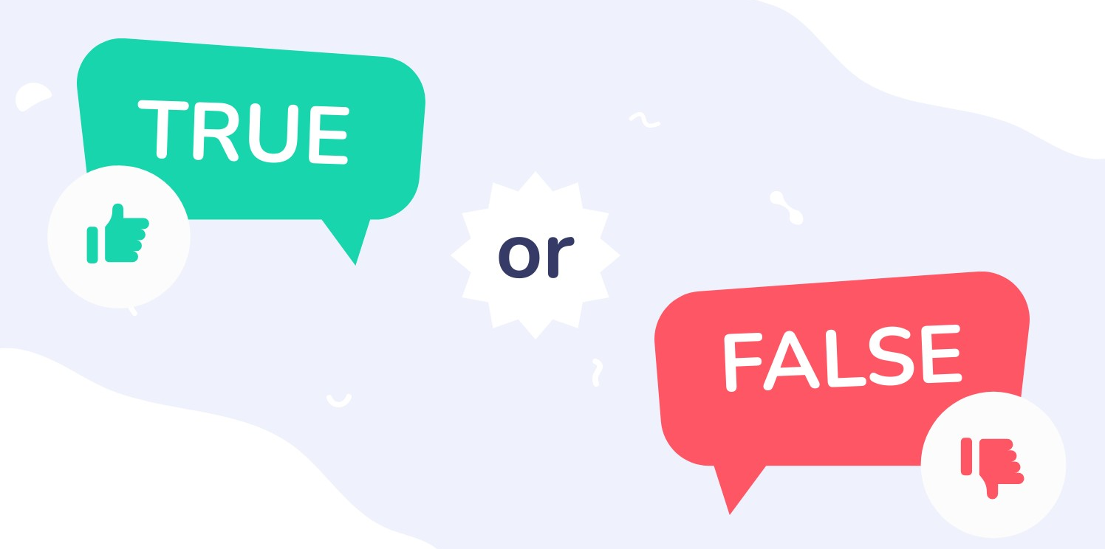
Notes:
T/F:
Feasible Clinicians –stay up to date evidence ALL the diseases
Pathways: evidence & possible in your context
Sometimes clinicians follow those pathways change practice, and sometimes not?
Finally, YOU KNOW WHY pathways work sometimes but not others

Slide 3
Goal
Think like an implementation scientist
Understand HOW pathways work
WHY they do or don’t work
Improve care
Reduce unwarranted variation
Improve outcomes & safety
Promote high-value care
Teach clinicians
Improve quality & efficiency
Notes:
I want you to think like an IS so you can understand how and why pathways do/don’t work in your context so your hard work to write pathways improves care

Slide 4
What is a chair?
Notes:
I want you to think about a chair (the thing not the person).
What is is, why do we have them?
What comes to mind?
Platform with 4 legs
Something you sit on

Slide 5
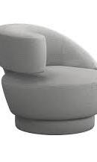
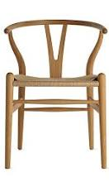
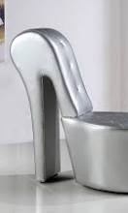
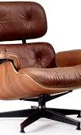
What is a Chair?
Notes:
if you were picturing the high heal shaped chair, we should definitely chat
Some of you described a chair as something you sit on

Slide 6
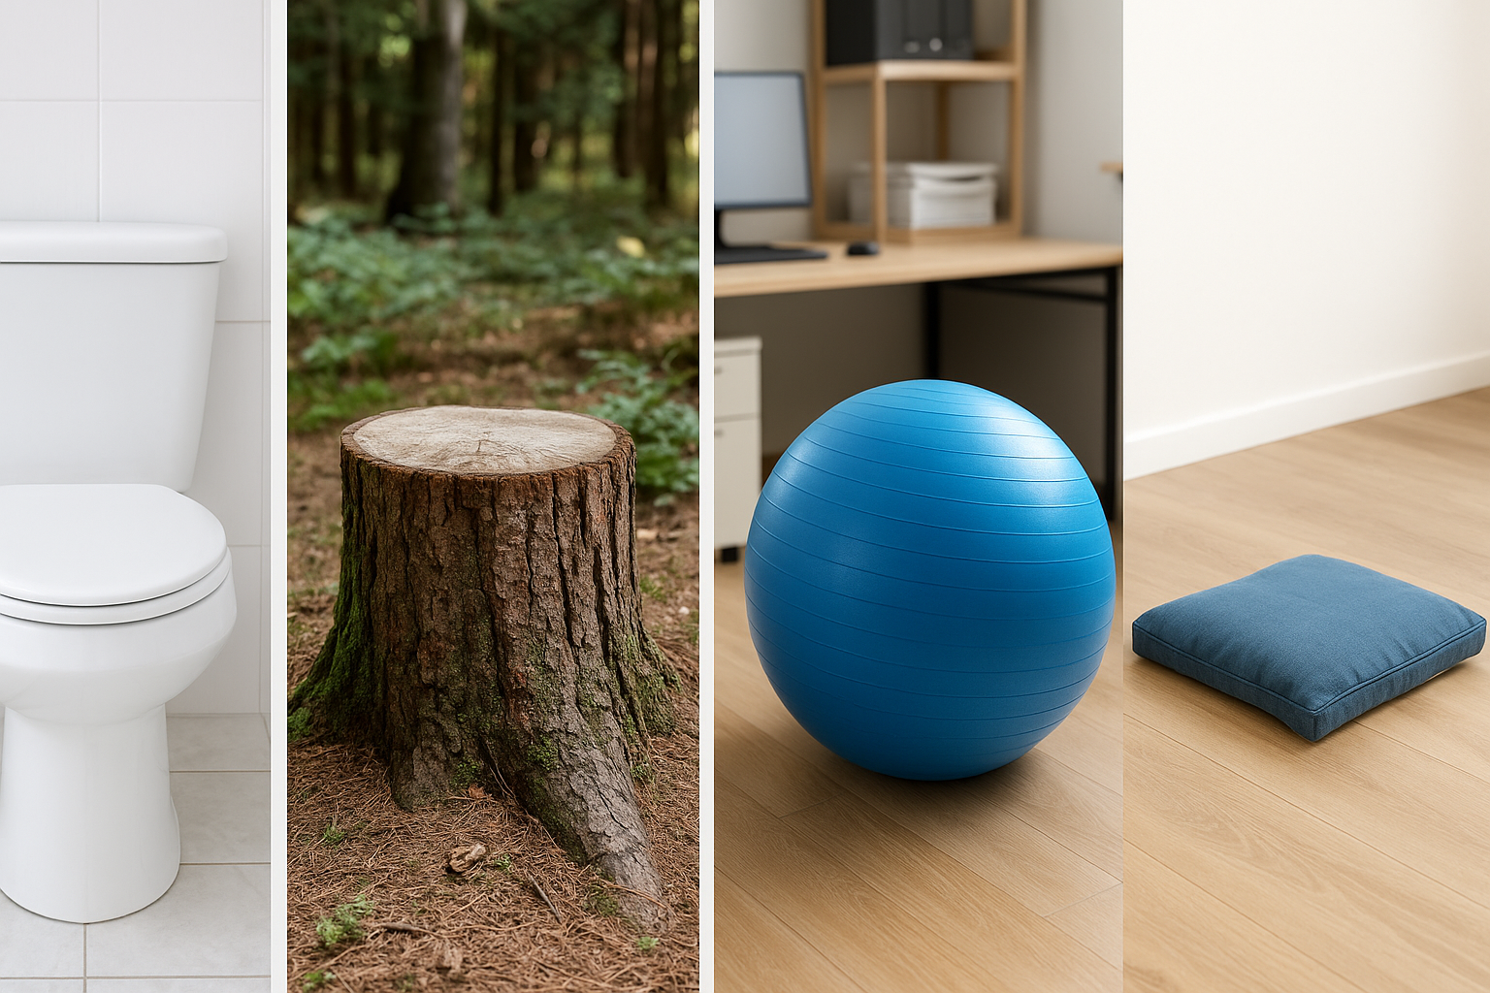
What is a chair?

Slide 7
Form vs. Function
Notes:
FORM:
FORMAT of an intervention, Content, layout, how we operationalize it
FUNCTION:
Purpose, effect --- What it is intended to do

Slide 8
What is a Pathway?
Notes:
Just as chairs have a form and function, so do pathways.

Slide 9
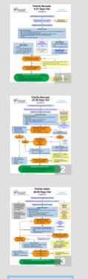
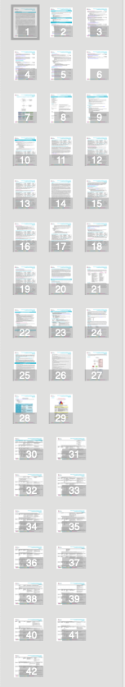
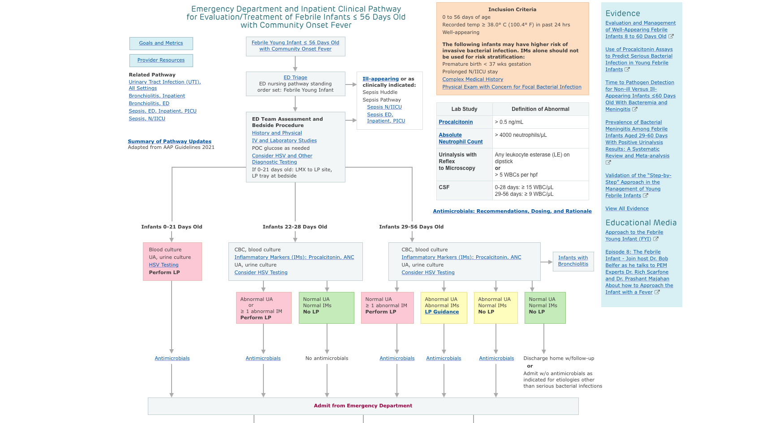
Form of a Clinical Pathway
  Algorithms
  High level summary of evidence
  Instructions for care
Notes:
Forms
Content, layout
Algorithms
high level summary of evidence
instructions for care
Multidisciplinary meetings
Consensus discussions

Slide 10
Form of a Clinical Pathway
  Algorithms
  High level summary of evidence
  Instructions for care
  Multidisciplinary meetings
  Consensus discussions
Notes:
Forms
Perhaps part of the form is how we operationalize pathways – Meetings Consensus discussions.
Algorithms
high level summary of evidence
instructions for care
Multidisciplinary meetings
Consensus discussions

Slide 11
Form of a Clinical Pathway
Notes:
Forms
Febrile infants
Algorithms
high level summary of evidence
instructions for care
Multidisciplinary meetings
Consensus discussions

Slide 12
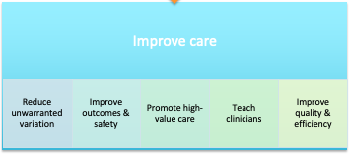
Core Functions of Clinical Pathways
  Elements that you hypothesize change practice
Notes:
What do pathways DO?
What do they accomplish?
Share (chat)

Slide 13
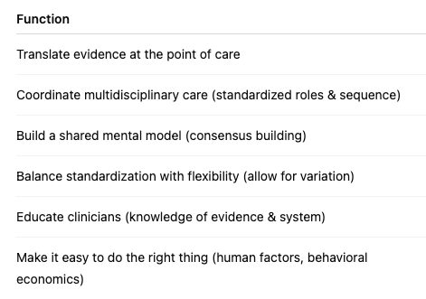
Core Functions of Clinical Pathways
Notes:
Coordinate multidisciplinary care (standardized roles and sequence of care)
Shared mental model (consensus building)
Translate evidence (available at point of care)
Many times that evidence is not word for word what is in a national guideline
One core function of pathways is to adapt evidence to your context, To translate the evidence to something that will work in your context.
Flexible (allow for variation)
Educate (knowledge of evidence/system)
Make it easy to do the right thing (human factors, behavioral economics)

Slide 14
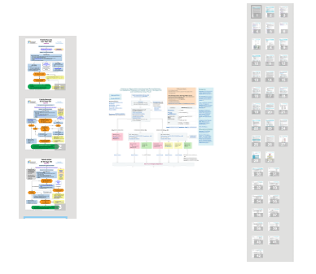
Form vs Function
Notes:
Important for thinking about adaptation. Adaptation is an important concept in IS. We are going to walk through it.
Let's think about pathways for diseases that have national guidelines like bronchiolitis or asthma.
Despite high quality evidence and national guidelines, pathways for bronchiolitis and asthma look different from hospital to hospital.
Some of that may not be grounded in science, but some of it is likely because those writing the pathways have adapted the evidence to their local context.
What is adapatation?

Slide 15
Adaptation of Intervention (Evidence)
A process
Make deliberate changes
Design
Delivery
Improving fit to context
Improve effectiveness
Notes:
For pathways this looks like
Make changes to the Format or content of a pathway
or even to the tools that often accompany pathways like order sets or note templates.

Slide 16
Adaptation of Intervention (Evidence)
A process
Make deliberate changes
Design
Delivery
Improving fit to context
Improve effectiveness
Preserve the Core Functions
Notes:
Preserve the core functions of the pathway

Slide 17
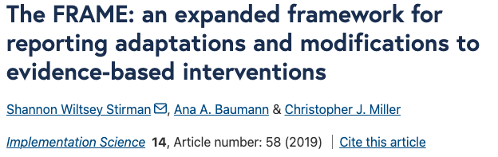
FRAME
Notes:
Like many things in IS,
adaptatation can be guided by frameworks.
Framework for reporting adaptations and modifications - expanded

Slide 18
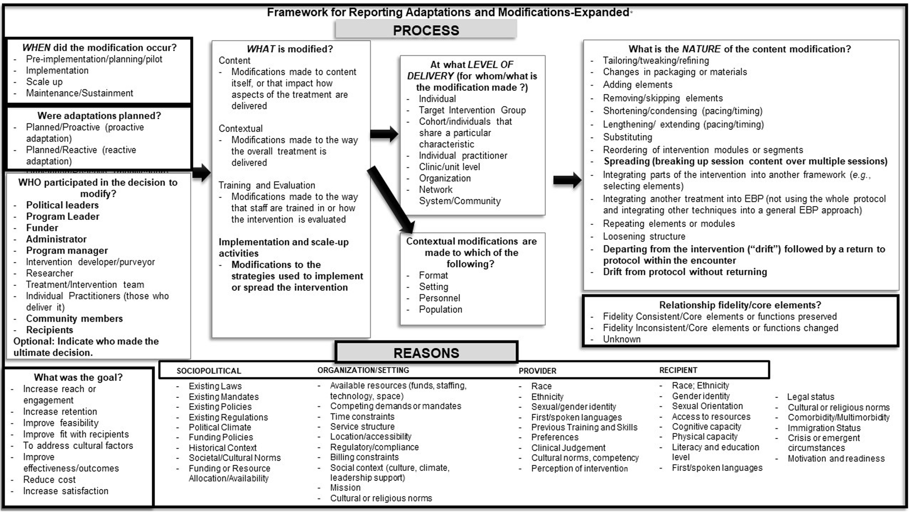
Notes:
What are you changing?
How are you changing it?
How are you making sure your core functions are preserved?
Treatment recommendations, perhaps a drug is not available to your patients based on insurance coverage
Maybe the evidence calls for one imaging modality, but it isn't available in your context
Or perhaps you are changing the typical format of your pathway. Maybe an algorithm isn't the right format. Or maybe the noon lecture you give to your residents when a pathway rolls out needs to be replaced by simulation.

Slide 19
Adaptation of Intervention (Evidence)
A process
Make deliberate changes
Design
Delivery
Improving fit to context
Improve effectiveness
Preserve the Core Functions
Notes:
When we make changes to pathways it is so that the pathway fits better in our context.
What do I mean by context?

Slide 20
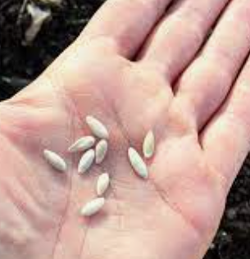

Context
Notes:
Use a gardening analogy.
Seeds are the evidence or the pathway – what you want people to do or adopt.
soil, the fertilizer are the tools we use to implement our pathways (like order sets)

Slide 21

Context
Notes:
Context is everything else.
The climate and the weather. The things we can’t control.
Context explains why a pathway works at one hospital but not another.
Or why your tomatoes grow in Oklahoma but not Alaska.

Slide 22
Adaptation of Intervention (Evidence)
A process
Make deliberate changes
Design
Delivery
Improving fit to context
Improve effectiveness
Preserve the Core Functions
Notes:
Because we can’t always change our context, we have to adapt to it.
You can think of context as the set of barriers and facilitators to your pathway implementation.

Slide 23
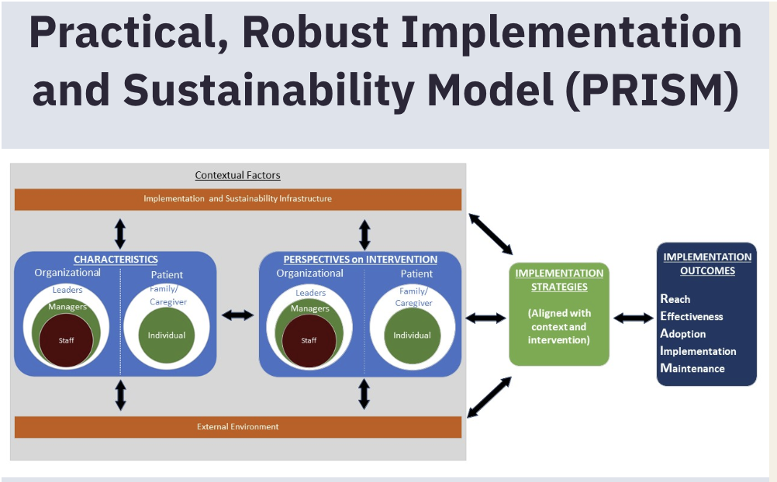
Fit to Context
Notes:
Set of barriers to adoption of the evidence or implementation of your pathway
consider at all levels organizational, provider level and patient level adapting.
In IS we use Frameworks to help guide our assessment of context. One such frameworks is PRISM.
How the pathway or evidence fits organizational or your patients, consider resources necessary for implementation
Point out your pathway teams work in and therefore know your context well

Slide 24
What is important in your context?
What form do you hypothesize will work in your context to achieve the function?
Notes:
The purpose of considering your context is so that you can
Adapt the format of your pathway to fit the context WHILE preserving the function of the pathway

Slide 25
Adaptation of Intervention (Evidence)
A process
Make deliberate changes
Design
Delivery
Improving fit to context
Improve effectiveness
Preserve the Core Functions
Notes:
How do we know if we have improved fit to context and
Improved effectiveness?

Slide 26
Goal
Think like an implementation scientist
Understand HOW pathways work
WHY they don’t
Improve care
Reduce unwarranted variation
Improve outcomes/safety
Promote high-value care
Teach clinicians
Improve quality/efficiency
Notes:
We write pathways to improve care
Improve patient health outcomes, safety, efficiency

Slide 27
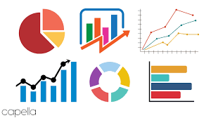
Measurement
Measure impact of pathways on outcomes
Notes:
You have done a lot of work in your org and in this group to measure the impact of pathways on outcomes
To understand if Pathways are improving care

Slide 28
Measurement
How are they working (function)?
Why do they work (or not)?
Understand reasons they do or do not accomplish the core functions
Adapt to better accomplish the function
Notes:
Not just if they work
How and Why your pathways are working
Consider asking stakeholders whether pathways are accomplishing the core functions
If not, why?

Slide 29
Measurement
Outcome | Core Function | Form
Improved Efficiency | Prescribe standard roles and sequence of care | Algorithm
Decreased Variation |  | Order sets
If you aren’t seeing improved efficiency (time to antibiotics) or care continues to happen “out of order” (antibiotics before biopsy). Discuss with stakeholders and front-line providers.
Notes:
Osteo pathway:
Time to antibiotics
Biopsy with culture before antibiotics

Slide 30
What is a Pathway?
Notes:
So when thinking about pathways, I hope you will not only focus on form but also function

Slide 31
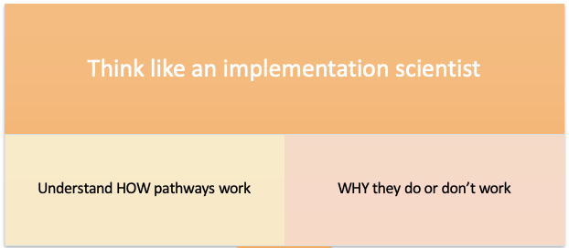
How and Why
Focus on the Function
Adaptation to Context
Notes:
By understanding the How and Why pathways work you can adapt them to context and improve outcomes

Slide 32
Discussion
How can Pathways4Kids support Implementation Science approach to pathways nationally?
What pathway successes have you seen because of a focus on function?

Slide 33
Resources
Website to explore IS frameworks
  https://dissemination-implementation.org/
FRAME framework to guide adaptations
  https://implementationscience.biomedcentral.com/articles/10.1186/s13012-021-01105-3
Article on Context
  https://pubmed.ncbi.nlm.nih.gov/40049220/
Primer on Implementation Science
  https://pubmed.ncbi.nlm.nih.gov/37301730/

