Slide 1
Enhanced Recovery After Surgery (ERAS)
Todd Glenski, MD, MSHA, FASA
Associate Professor of Anesthesiology, University of Missouri-Kansas City
Department of Anesthesiology
Department of Evidence Based Practice
Children’s Mercy Kansas City

Slide 2
ERAS Overview
What is ERAS?
Pathway creation & implementation
Data: collection and presentation
Academic endeavors
Lessons learned on the way
No financial disclosures

Slide 3
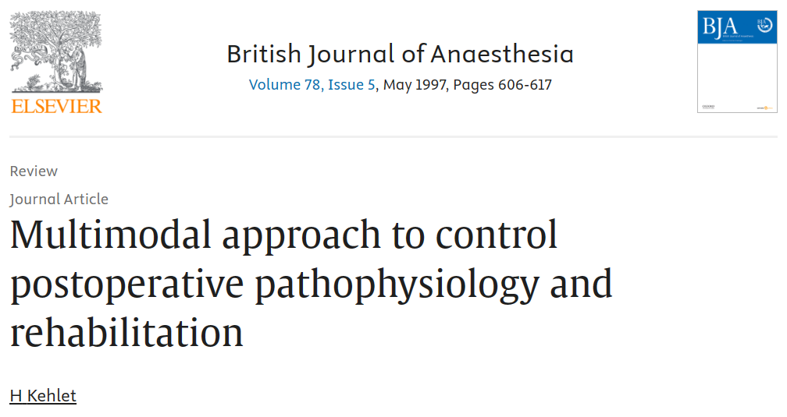
What is ERAS?
Evidence-based perioperative care pathways designed to enhance the optimization & recovery of surgical patients
  Multidisciplinary approach
  Focusing on factors such as preoperative education, intraoperative fluid management, multimodal opioid-sparing pain management, and early diet & mobilization
  Minimize unnecessary variation in care
  Increasing communication between teams
First described in adults for abdominal surgery, now becoming mainstream in pediatrics
ERAS is QI in nature, requiring PDSA cycles & continuous management

Slide 4
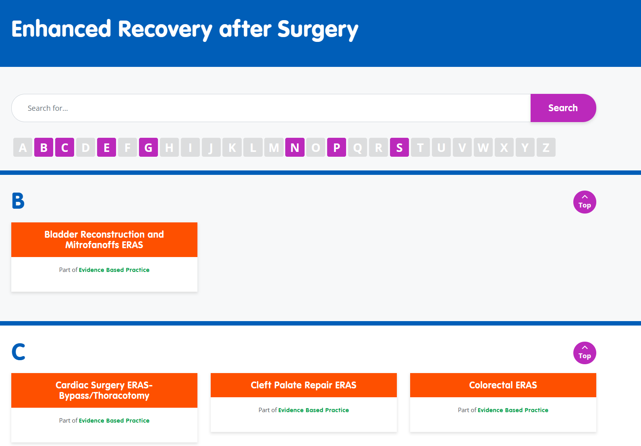
ERAS at Children’s Mercy
Department of EBP serves as the coordinator
Gastric sleeve surgery was first in 2021
Current pathways:
  Gastric Sleeve
  Complex Urology
  Cardiac Surgery (Bypass & Non-Bypass)
  Colorectal
  Sports Medicine
  Complex Ortho w/ CP
  Cleft Palate
  Idiopathic Spine
  Pectus Bar Insertion
  Endometriosis

Slide 5
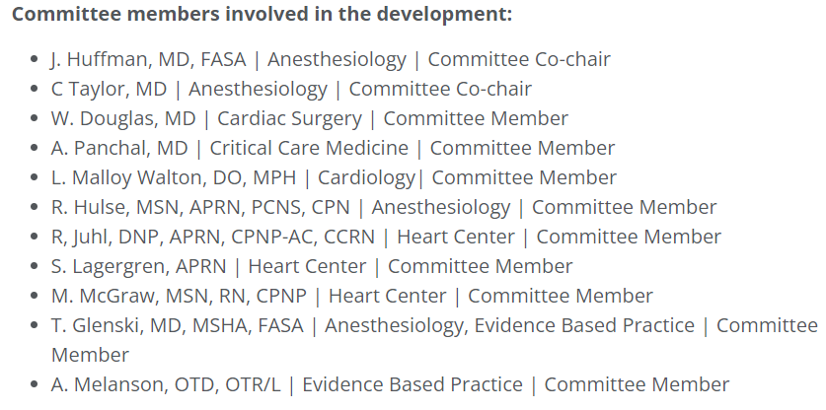
Pathway Creation
Attempt to get all key stakeholders
Must have champions!
Typical team includes: EBP (Program Manager & Medical Director), Surgeons, Anesthesiologists, Surgery APRN, Anesthesia APRN, Inpatient nursing, SDS/PACU

Slide 6
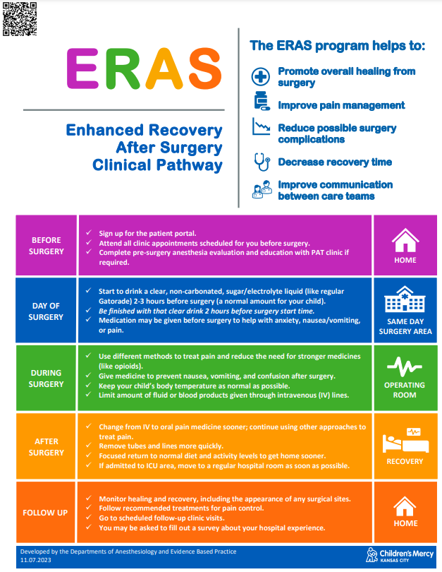
Patient/Family Engagement
Discussion begins in surgery clinic and/or PAT
Set some baseline expectations
  Preoperative carb loading
  Multiple ways to treat pain
  OOB
  Working towards discharge goals
Handouts are helpful
  Multiple languages

Slide 7
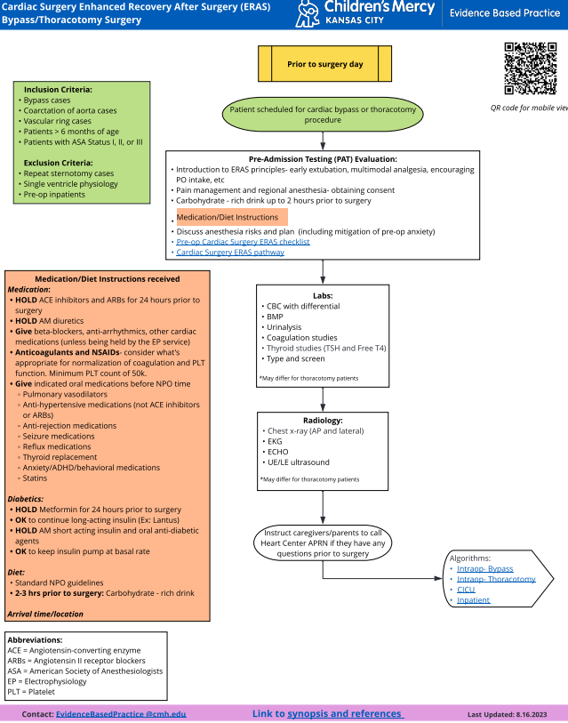
Preoperative Care
Clear pathway for APRNs to follow in clinics
Preop Bundle
  Last PO intake should be carbohydrate rich clears
  Drink up to 2 hours prior to surgery start
  Scopolamine, lovenox, diazepam

Slide 8
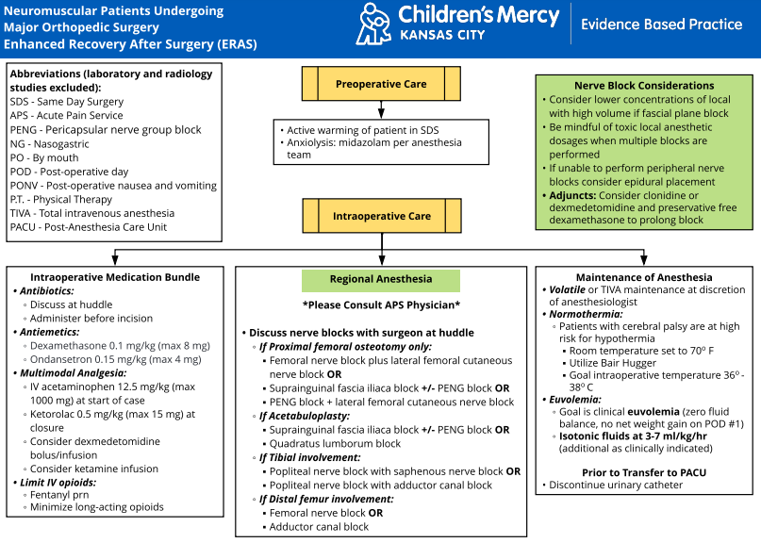
Intraoperative Care
Must be easily accessible for users
Intraop Bundle
  Appropriate ABX
  PONV prophylaxis
  Multimodal analgesia
  Normothermia
  Minimize long-acting opioids (Morphine, Hydromorphone)
  Euvolemia

Slide 9
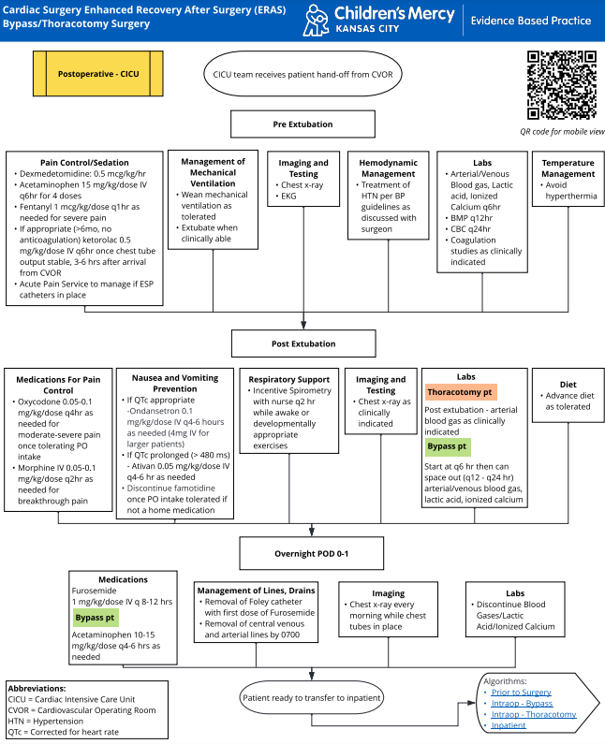
Postoperative Care
Must have buy-in once they leave the perioperative area
Postop Metrics
  Multimodal analgesia (Ex: acetaminophen, ketorolac)
  Extubation and time in CICU
  Chest tube removal
  First PO
  Diet orders
  Out of bed
  Length of Stay

Slide 10
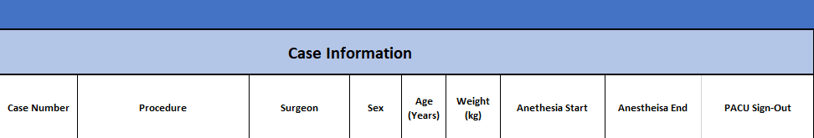
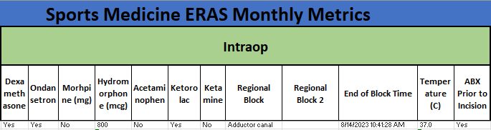
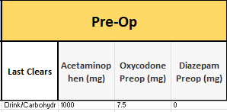
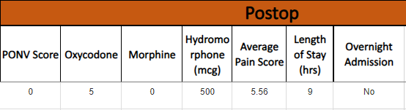
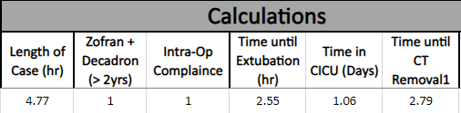
Data Collection
Monthly Reports
  Dedicated IT is helpful
Main Database

Slide 11
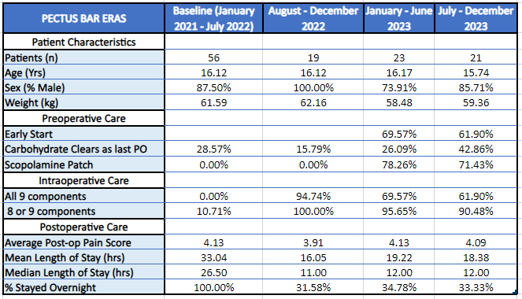
Data Presentation
Keep stakeholders in the loop!
Find a balance in reporting data

Slide 12
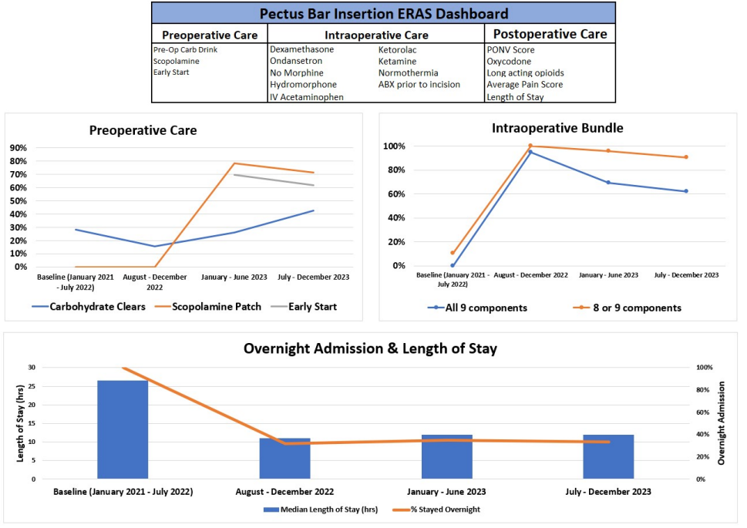
Dashboards

Slide 13
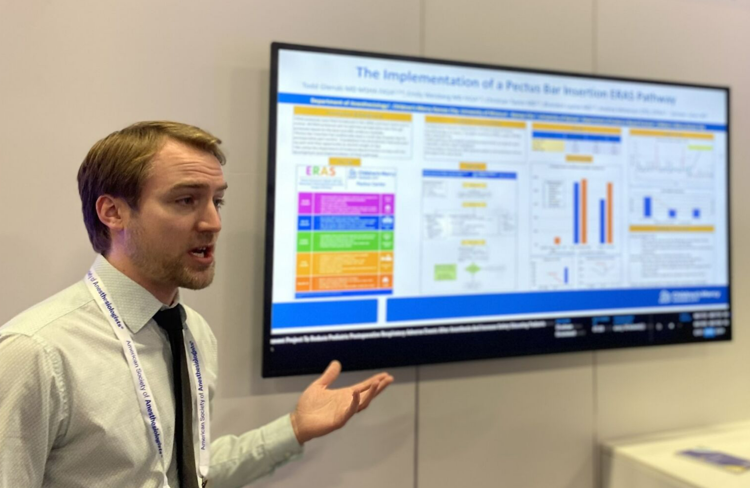
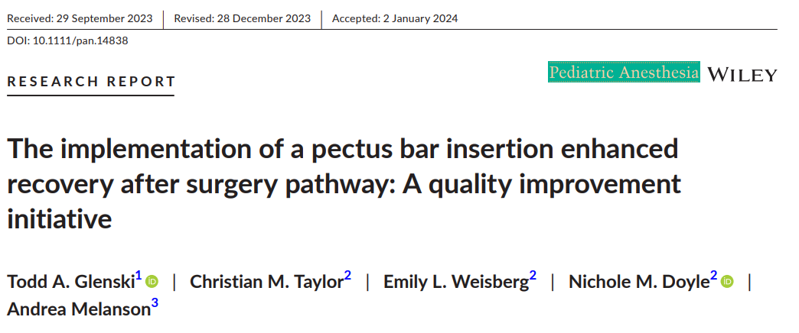
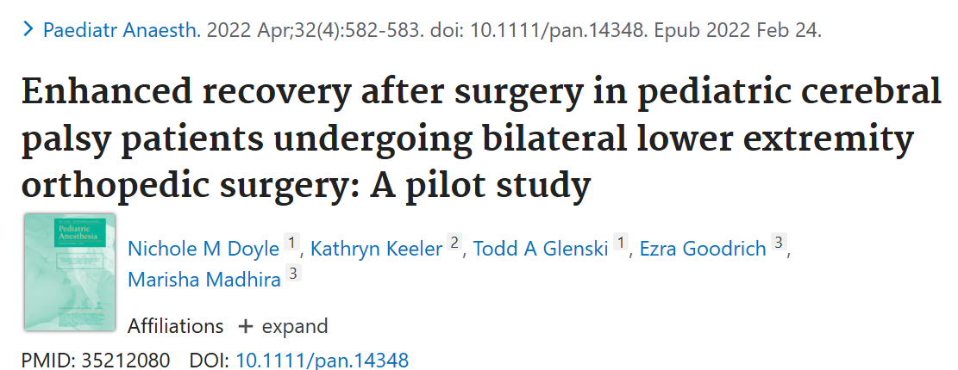
Academic Endeavors
Local/National Meetings, Publications (Anesthesiology, Surgery)

Slide 14
Potential & Ongoing Challenges
Your institution doesn’t have cultural buy in to support a successful perioperative pathway
  People are resistant to almost any type of change; “my way is the best way”
Important stakeholders are left in the dark
Pathway implementers aren't aware that a patient is part of a pathway or what the pathway entails
  Visibility is important
Data: how & what to measure, who to report back to
You forgot that PDSA cycles are relevant here
  Avoid the urge to think of the pathway as a “Set it and Forget it” entity.
  ERAS requires inputs of time, energy, and resources for it to survive AND succeed.
  Congrats you created a pathway, but forgot to review the data, obtain feedback, identify barriers to compliance, opportunities for improvement, etc.
  Closing the loop with stakeholders

Slide 15

Thank you!
Please email me with questions: tglenski@cmh.edu

